Slide 1

EECS Security Whirlwind Tour
Part 2: Linux DevOps
Ben Roose
Electrical Engineering and Computer Science Dept. Systems Administrator
ben.roose@wichita.edu
Notes:
So you've seen some of our servers and played with SSH
What next?

Slide 2
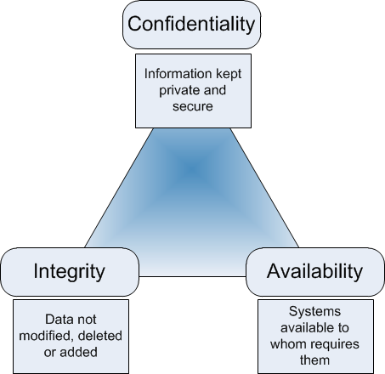
Fundamentals of a SysAdmin
Remember that it comes down to CIA!
From: Geraint Williams Blog “CIA & InfoSec” (9 Sep, 2012)
Notes:
Remember overall is the CIA Triad (Dr. Jadliwala)
Confidentiality = privacy of users and their data
Integrity = accuracy and trustworthiness of that data
Availability = making sure users can access that data

Slide 3

What are we talking about?
Service Security: Load-balancing
Policy Security: Automation of server management
Job Security: Skillsets for DevOps
Data Security: Always remember to backup!
Notes:
Quick run down of what we will talk about over the next 40 minutes!

Slide 4
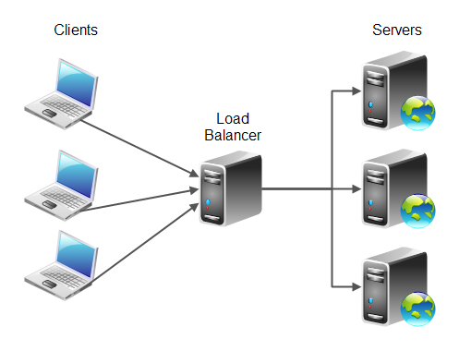
Load-Balancing
Distributing incoming network traffic across a group of servers
Allows for high redundancy and availability
Notes:
BEN DISCUSS EACH POINT
Mention this is big for web companies such as Google, Facebook, and Netflix!!
FUN DEMO: I Need five volunteers!!
1 as client, 1 as load-balancer, 3 servers
Round-robin !

Slide 5
Current Load-Balancing in EECS
No load-balancing in EECS research servers
  One server means one available connection
Manual load-balancing in EECS teaching servers
  Remote users choose to SSH into a specific server
  (kira, kirk, mccoy, sisko, or spock)
Static load-balancing in EECS teaching servers
  LTSP thin-clients are load-balanced during initial setup
Notes:
BEN DISCUSS EACH POINT
Research servers only have a limited subset of users
Teaching servers have a larger group of users
Manual requires knowledge from user to balance
Static does not scale out easily (think Netflix!)

Slide 6

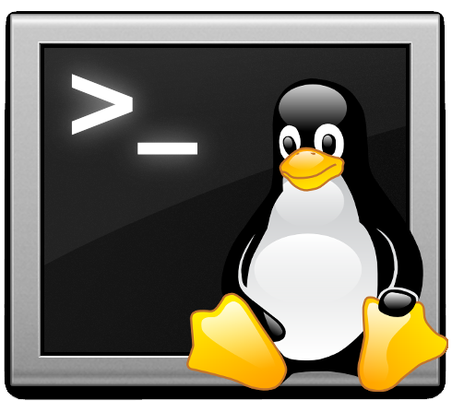

EECS Teaching Server Infrastructure
(70) LTSP
Thin-Client Terminals
(located in JB 205/206)
kirk1, kirk2, riker1, riker2
(7) Debian 7 VMs
(on KVM hypervisor)
kira, kirk, riker, spock
(3) Debian 7
KVM host servers
(located behind JB 205/206)
ayleborne, trefayne
Notes:
How does the EECS Linux lab work?
Logging into a Terminal → Accesses an LTSP VM → hosted on a physical KVM server
LTSP = Linux Server Terminal Project
VM = Virtual Machine
KVM = Kernel-based Virtual Machine (FOSS Hypervisor)
Infrastructure is about 10 years old

Slide 7

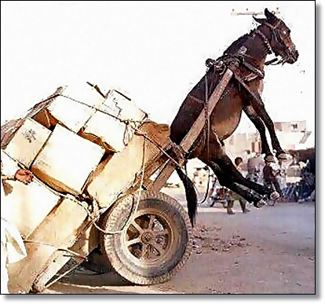

Problem 1: No dynamic balancing
If a user runs a computationally intensive process (program)...
...a high load is placed on a single virtual machine...
...but there is no method for the host server to assign additional physical resources to that virtual machine or running process!
Notes:
No Automatic Load-Balancing
It grinds to a halt!

Slide 8
Problem 2: Server Cascade Failure
...and their thin-client terminals fail!
...then its hosted virtual machines fail...
If a host server fails...
Notes:
Host server fails or even reboots!
How many physical servers? 3
How many thin-clients? 70
Thin Client/Server Ratio ~ 24:1
Not counting remote logins!
Q: What about if one of the research servers goes down?

Slide 9
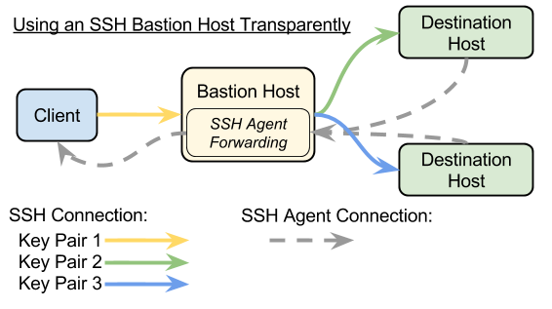
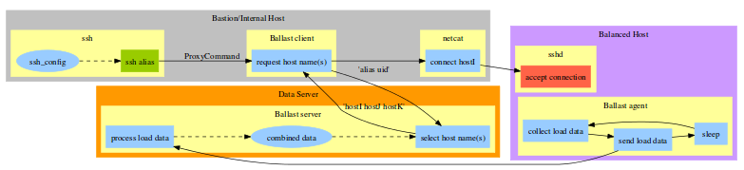
Dynamic Load-Balancing for SSH
Use SSH agent forwarding through a hardened proxy (bastion host)
From: Rob Giseburt blog “Using SSH Through a Bastion Host Transparently”
From: Paul Kolano “Dynamic Load Balancing of SSH Sessions Using User-Specific Selection Policies” (22 Jun, 2010)`
Use Ballast SSH dynamic load-balancer
Notes:
BEN DISCUSS EACH POINT
Ballast developed by NASA for Pleiades supercomputer

Slide 10
Automate Your Security Policy
Manual deployment/management of servers (traditional SysAdmin)
  More servers, more deployment, more maintenance, more work!
  Less efficiency, less integrity, less stability, less security!
  Does not scale out well
Automation tools allow for enforcement of policy (modern DevOps)
  CFEngine, Puppet, Chef, Salt Stack, and Ansible
  “Develop one policy, deploy many servers”
  Can scale out easily and quickly
Many of these work on the ideals of Promise Theory
  Proposed by Mark Burgess in 2004
  “a model of voluntary cooperation between individual, autonomous actors or agents who publish their intentions to one another in the form of promises.”
Notes:
BEN DISCUSS EACH POINT
Data integrity and availability
The more you do manually, the more you can get wrong, and the more you forget to do on each system!
Automation relies on good programming methods
The deployment is only as good as the developer

Slide 11
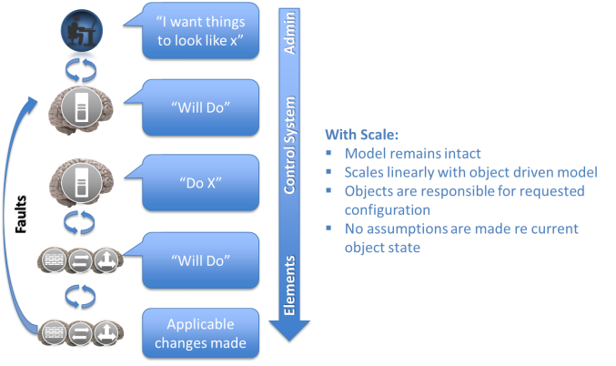
Promise Theory
From: Jan. A. Bergstra and Mark Burgess “An Introduction to Promise Theory” (11 Oct, 2013)
Notes:
BEN DISCUSS EACH POINT
Data integrity and availability
The more you do manually, the more you can get wrong, and the more you forget to do on each system!
Automation relies on good programming methods
The deployment is only as good as the developer

Slide 12
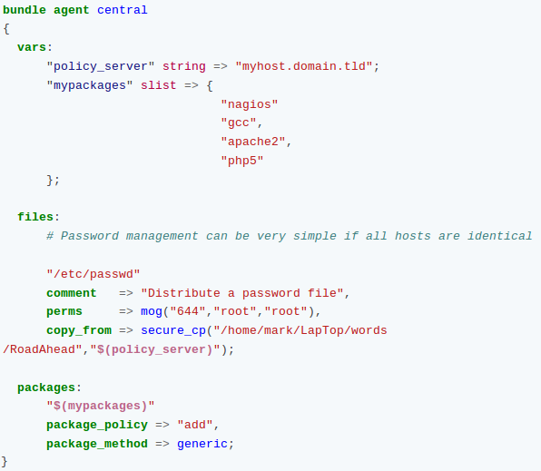
CFEngine Example Policy
Notes:
BEN DISCUSS EACH POINT
Data integrity and availability
The more you do manually, the more you can get wrong, and the more you forget to do on each system!
Automation relies on good programming methods
The deployment is only as good as the developer

Slide 13
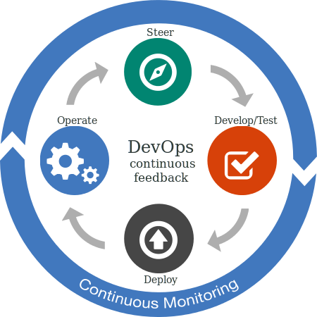
DevOps: The Future of SysAdmins
Automate once, deploy many!
From: “IBM Performance Management for DevOps”
Notes:
BEN DISCUSS EACH POINT
Talk about the shift to cloud/mobile computing, scaling out of clusters, and the push towards open source technologies!

Slide 14
DevOps Skillsets
What areas of knowledge do you need to get into this field?
Strong theoretical computer science knowledge
  System architecture, databases, networking, security, etc.
Modern (but open) scripting programming languages
  Bash, Python, Perl, Ruby, and Java (plus SQL)
Open Source technologies
  Linux distributions and tools: LAMP and beyond
Automated configuration tools:
  CFEngine, Puppet, Chef, Salt Stack, and Ansible
Cloud clustering and virtualization toolsets
  OpenStack and KVM
Notes:
BEN DISCUSS EACH POINT
Ask if you'd like advise on specific certifications or paths

Slide 15
Backup, Backup, Backup!
One copy is not a backup, no matter how secure you believe it to be!
Always keep at least two copies MINIMUM
Use version control solutions: Google Drive, Git, Subversion
As a sysAdmin, assume your users do not do regular backups
Use automated tools and scripting: rsync is your friend
REMEMBER THE SAYING:
  “Storage is cheap, data recovery is not!”
Notes:
BEN DISCUSS EACH POINT
Last thought – Back up that data!
Data integrity and availability

Slide 16
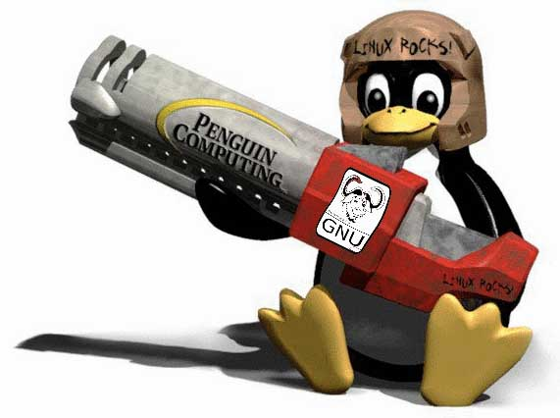
WuLUG
Wichita State University Linux User Group
MEETING TONIGHT IN LINUX LAB 5:30-7pm: Webservers & Curl

Slide 17

Thank you
Questions?
Ben Roose: ben.roose@wichita.edu

Slide 18



This work is licensed under the Creative Commons
Attribution-ShareAlike 4.0 International License.
To view a copy of this license, visit http://creativecommons.org/licenses/by-sa/4.0/.
Wichita State University

